Slide 1

Face RECOGNITION AND ALBUM SEPARATION based on OpenCV

Slide 2
Objective:-
The objective of our project is to design software that can detect human faces from an image and transfer to the required destination.

Slide 3
FACE DETECTION

Slide 4
FACE RECOGNITION:-
Face recognition is a computer technology being used in a variety of applications that identifies human faces in digital images and videos.
Face recognition can be regarded as a specific case of object-class detection. In object-class detection, the task is to find the locations and sizes of all objects in an image that belong to a given class. Examples include upper torsos, pedestrians, and cars.

Slide 5
Why we choose Face Recognition?
• Compatible with Modern Era.
• Not common in JAVA
.• Basic programme for Recognition(Recognition is not possible without Detection
Security Maintenance and Media Empowering
.• Needed for visual applications in Robotics.

Slide 6
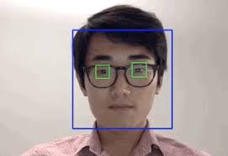
Human face detection

Slide 7
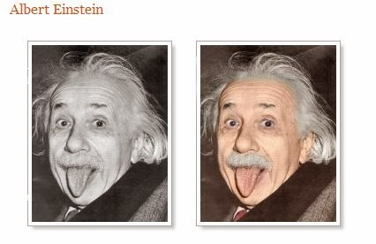
Procedure at a Glance:-
The input is a colored image
There are multiple faces with frontal view and upright orientation
The size of faces within the image should approximately be the same
Little deviation in brightness for all the faces within the image
Faces have to be greater than a certain size in the image so that facial features can be detected.
Standard dimension is not more than 1600 X 1200 px.

Slide 8
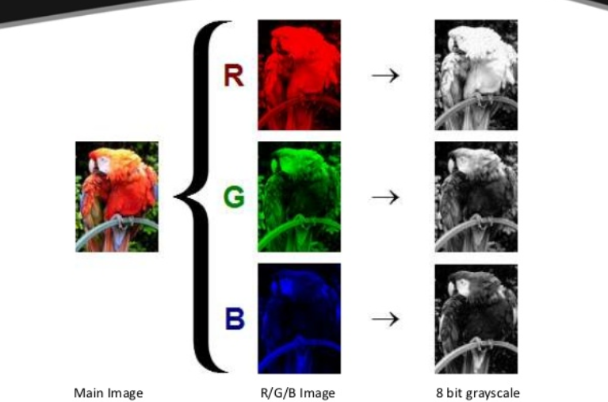

Slide 9

OpenCV
OpenCV (Open Source Computer Vision) is a library of programming functions mainly aimed at real-time computer vision

Slide 10
Classifier:-
A computer program that decides whether an image is a positive image (face image) or negative image (non-face image) is called a classifier
HAAR CLASSIFIER
LBP CLASSIFIER

Slide 11
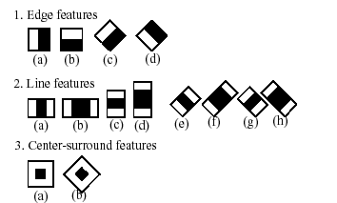
HAAR CLASSIFIER

Slide 12
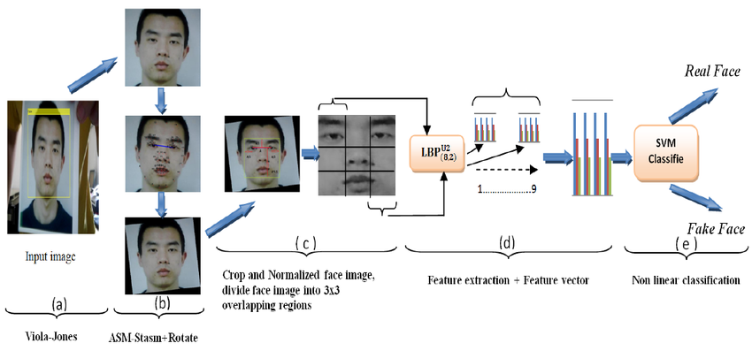
LBP CLASSIFIER

Slide 13
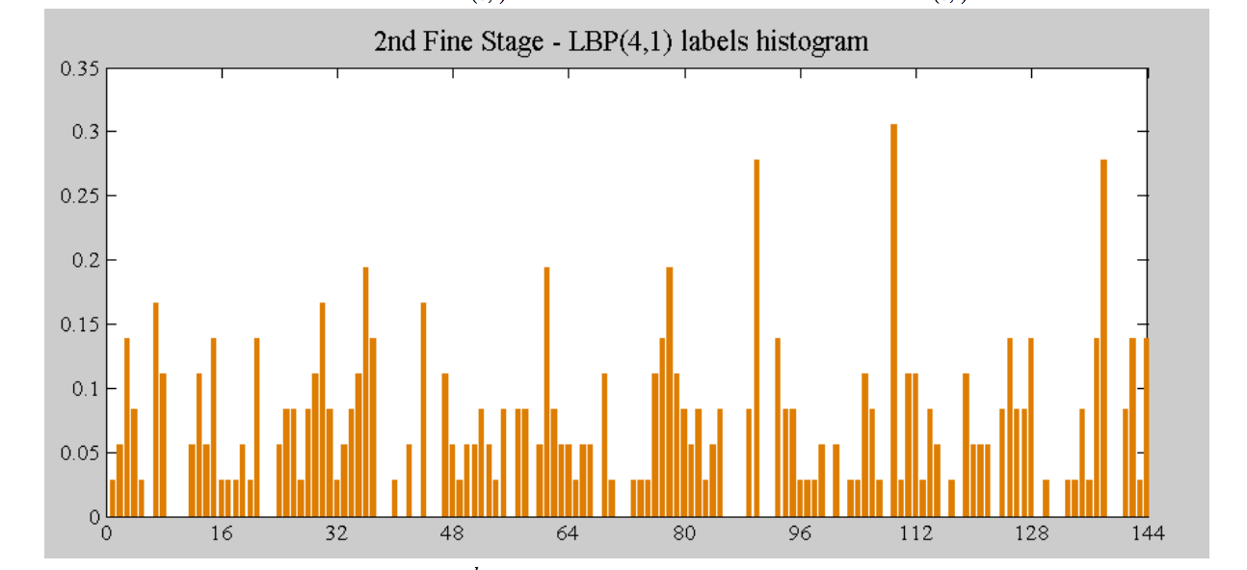
Histogram
A histogram is an accurate representation of the distribution of numerical data.

Slide 14
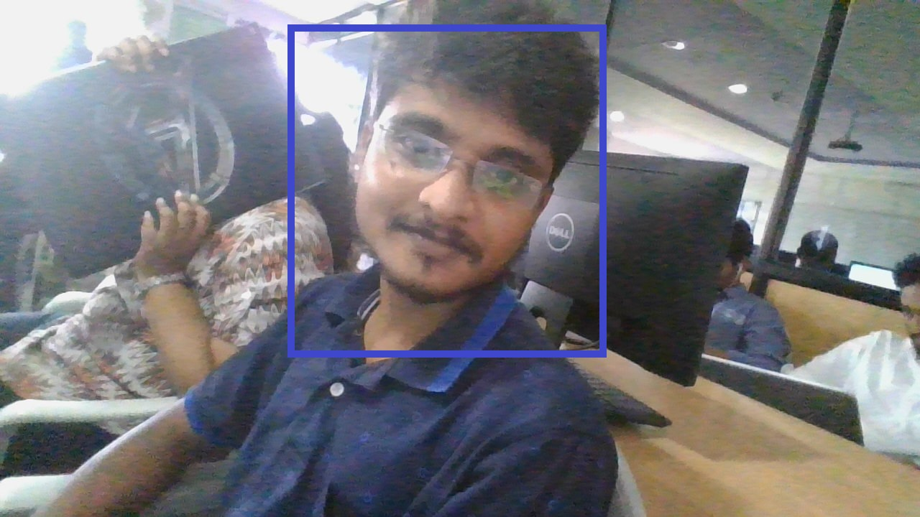
Dataset:-
The first (of many more) face detection datasets of human faces especially created for face detection (finding) instead of recognition.
Our dataset with 24 images with human faces, recorded under natural conditions, i.e. varying illumination and complex background. The eye positions have been set manually (and are included in the set) for calculating the accuracy of a face detector.
A formula is presented to normalize the decision of a match or mismatch. This is, to my knowledge, the first attempt to finally create a real test scenario with precise rules on how to calculate the accuracy of a face detector – open for all to compare their results in a scientific way!

Slide 15
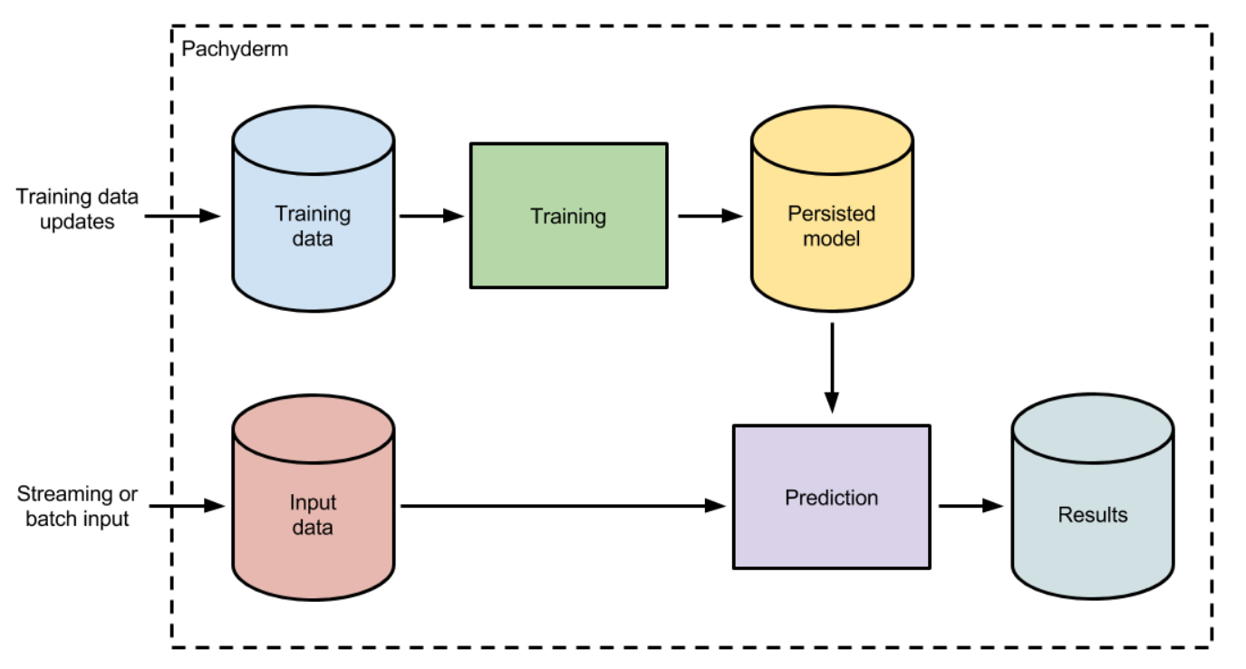
Why training data?
Machines are much faster at processing and storing knowledge compared to humans. But how can one leverage their speed to create intelligent machines? The answer to this question – make them feed on relevant data. This is also referred to as Training data.
Machine learning models are not too different from a human child. When a child observes a new object, say for example a dog and receives constant feedback from its environment, the child is able to learn this new piece of knowledge.

Slide 16
start
Face image
LBP
Feature Extension
stop
Training set
Face Recognized
Input Image
LBP Classifier
Confidence above 55
Calculate Confidence
Face image
Face not recognized

Slide 17
THANK YOU☺

